Slide 1
Steel Image Segmentation
Weekly Update
2023-07-01
Recent Update – 2023-07-04

Slide 2
Unique Observations from Experiments
7x7 Kernel
ReLU + Focal
16 Channels
50 epochs
Avg (10)
Avg (8)
(1)
(1)
(1)
 | x3000 | x5000 | test1 A type | test2 D3 type | test3 H2 type
Normal Weighted – Dataset Wide | 0.7721 | 0.8848 | 0.6903 | 0.7837 | 0.6902
Weighted Per Class, Dilation – 2, Dropout – 0.4 | 0.8770 | 0.9112 | 0.7366 | 0.3988 | 0.7481
Dice Score
Possible Reason?
Weighted class per batch assigns different weights to each class based on their prevalence in the training data. If the class distribution is highly imbalanced, and if the weights are not appropriately tuned, it can result in improper training.
I tried thinking of other reasons, but model seems to perform better in all cases except D3 type.
Dice

Slide 3
Comparisons
Avg (10)
Avg (8)
(1)
(1)
(1)
 | x3000 | x5000 | test1 A type | test2 D3 type | test3 H2 type
Normal Weighted – Dataset Wide | 0.7721 | 0.8848 | 0.6903 | 0.7837 | 0.6902
Weighted Per Class, Dilation – 2, Dropout – 0.4 | 0.8770 | 0.9112 | 0.7366 | 0.3988 | 0.7481
UNet 3+ | 0.7705 | 0.7932 | 0.6491 | 0.7272 | 0.7471
Normal Weighted – Dataset Wide + Unet 3+ Loss | 0.7709 | 0.8895 | 0.7194 | 0.7692 | 0.6950
7x7 Kernel
ReLU + Focal
16 Channels
50 epochs
3x3 Kernel
ReLU + (Combined loss)
16 Channels
50 epochs
+ Combined Loss
Dice Score
Dice

Slide 4
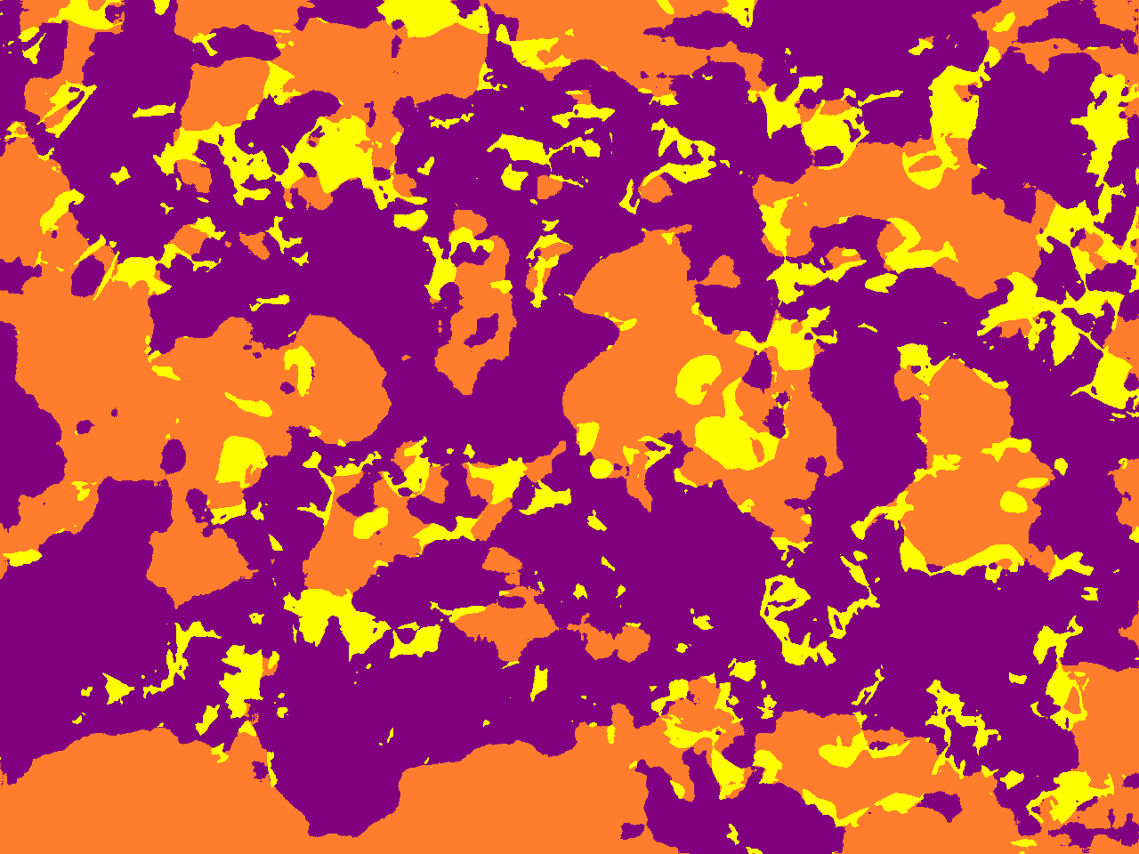
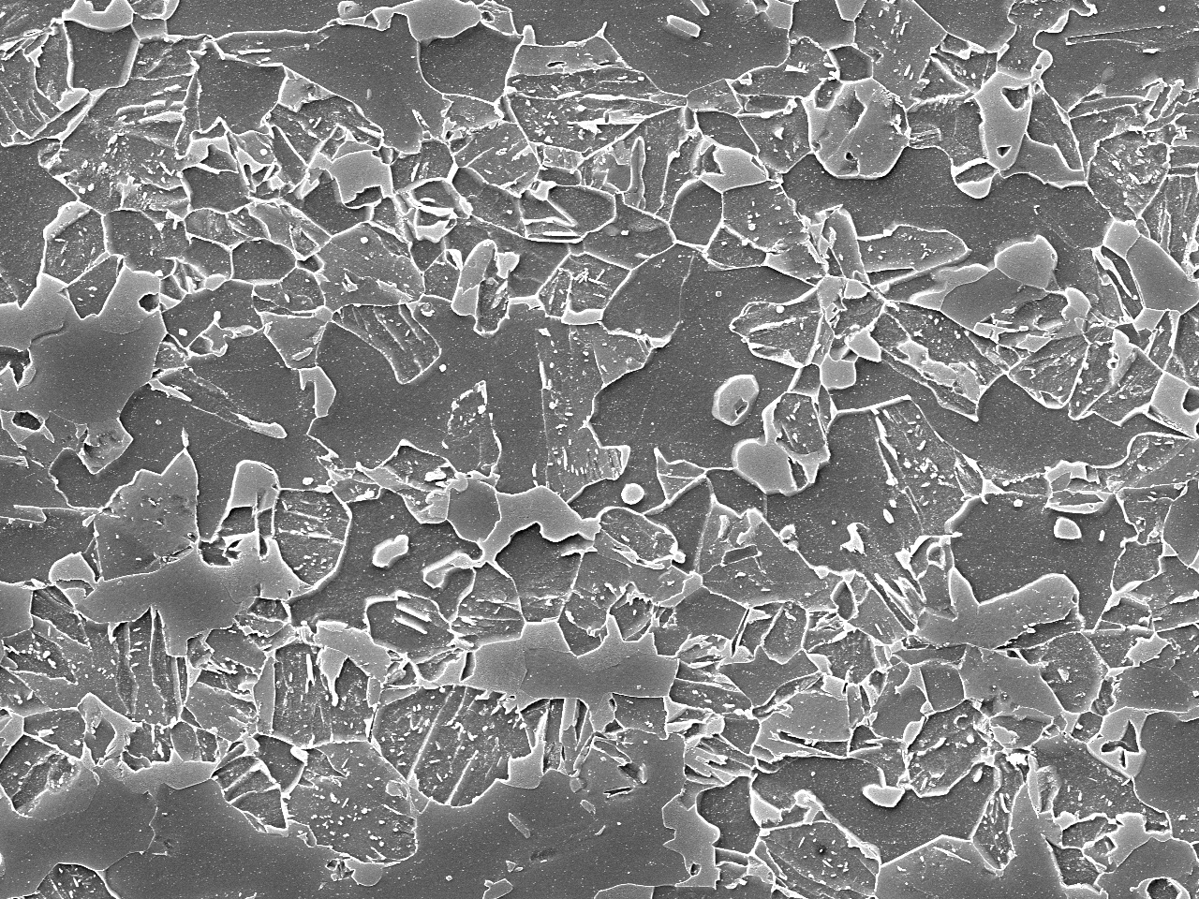
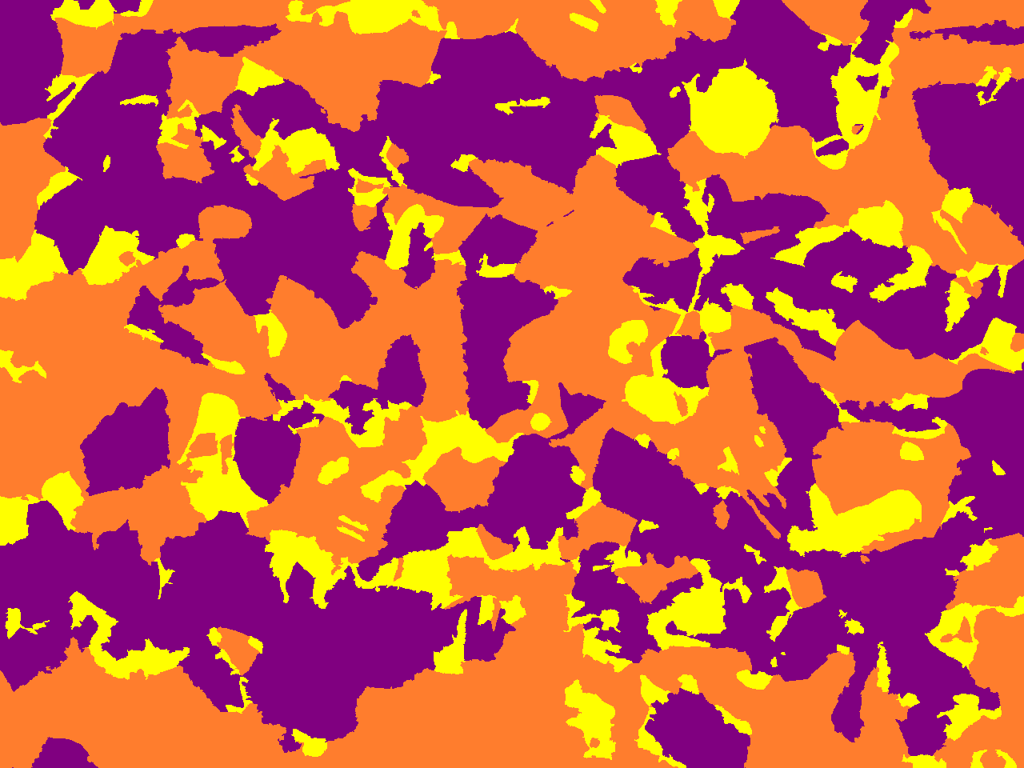
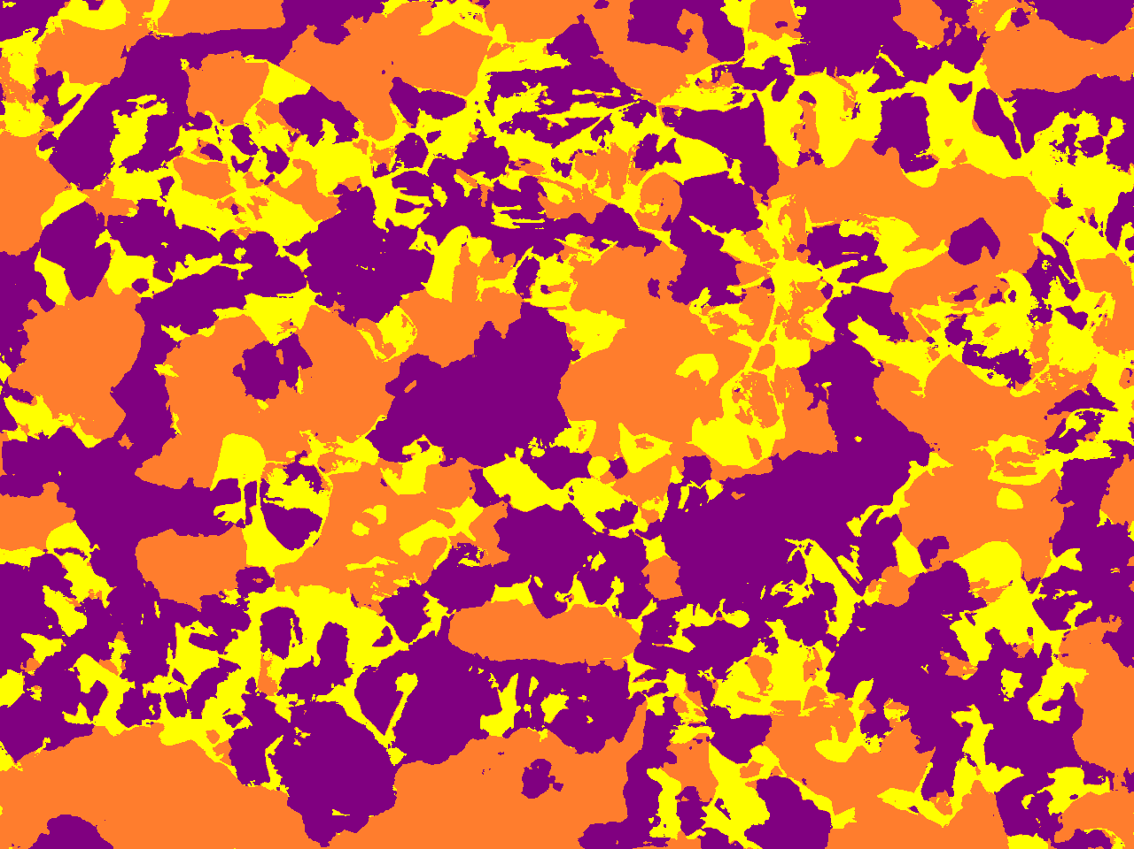
Comparative Images
A - Type
Our UNET Dice Score – 0.69
UNET 3+ Dice Score – 0.6491
Dice

Slide 5
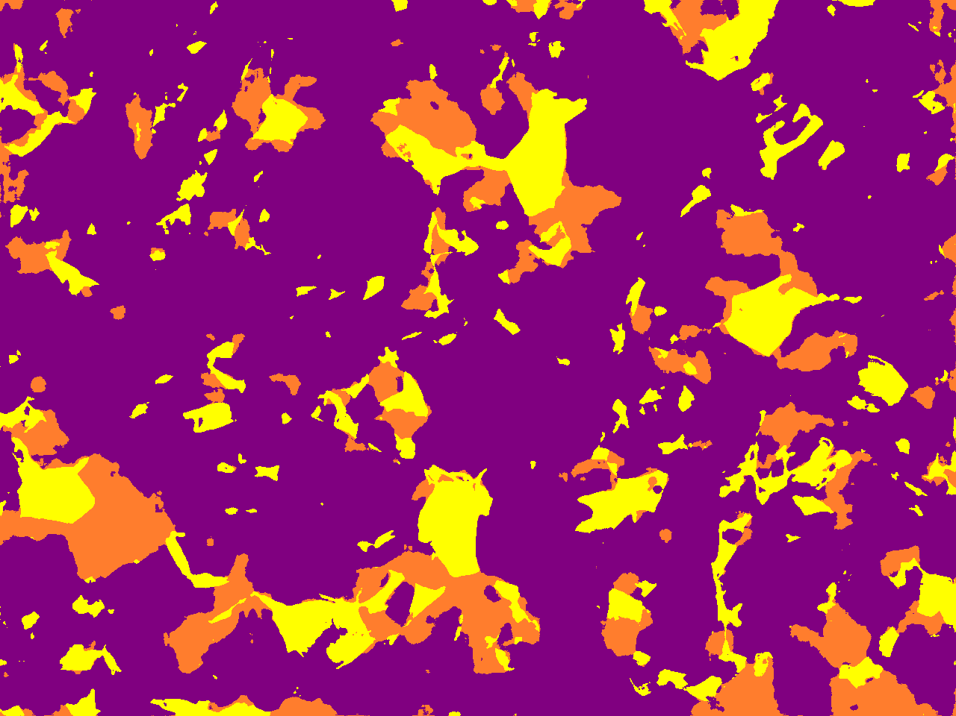
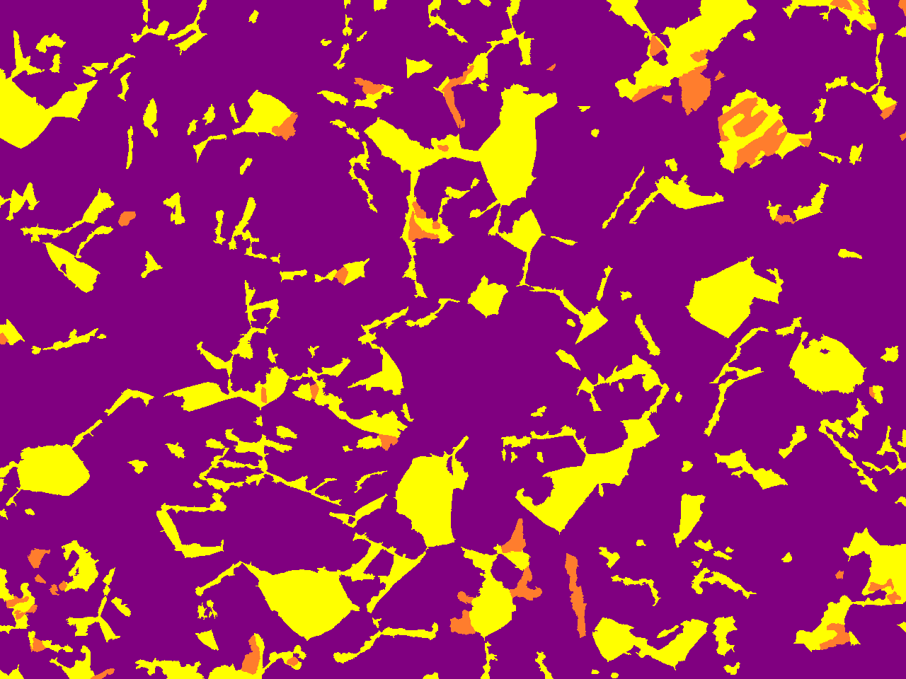
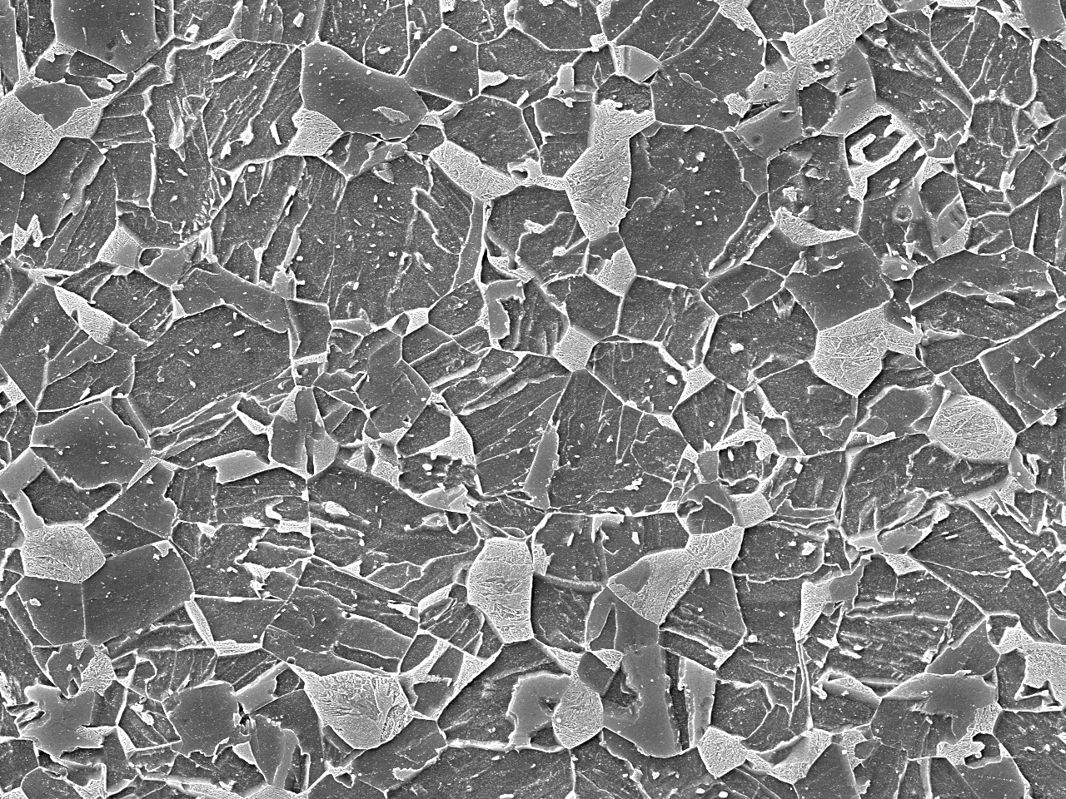
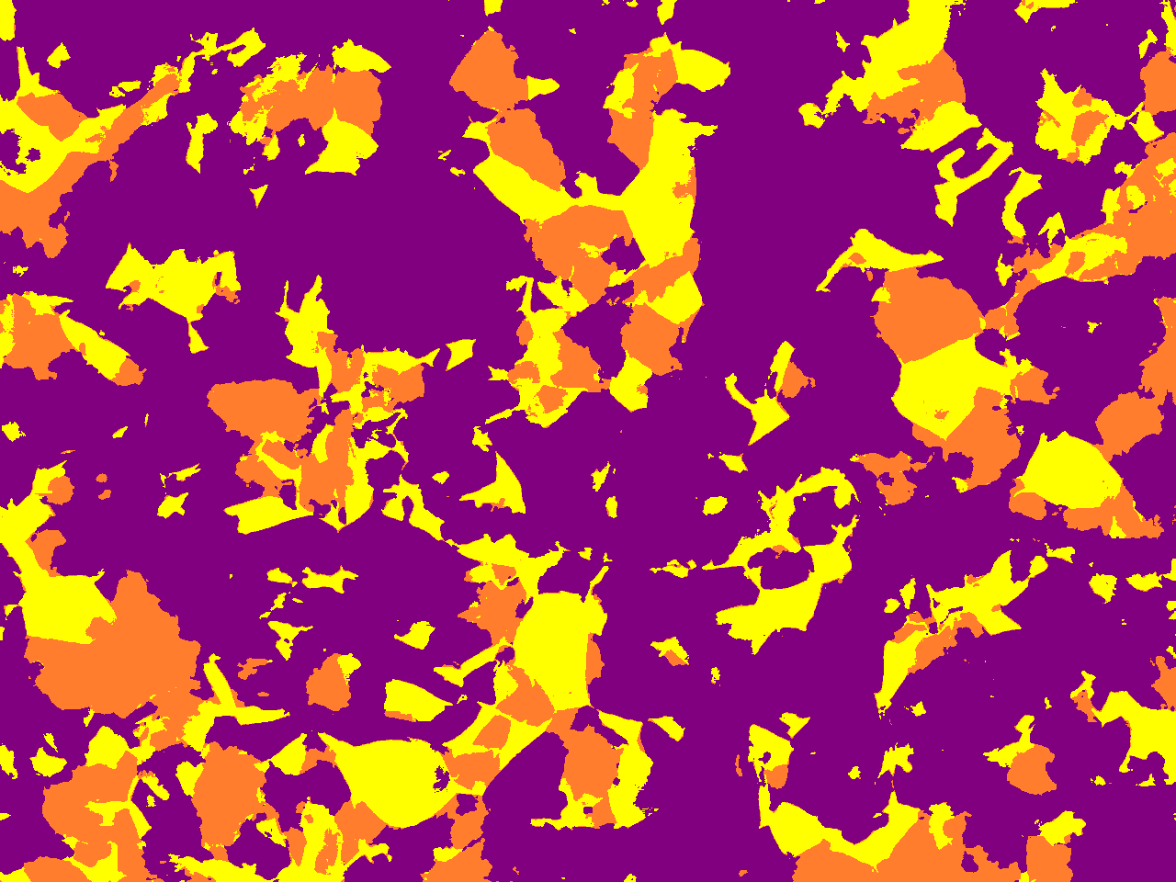
Comparative Images
D3 - Type
Our UNET Dice Score – 0.7837
UNET 3+ Dice Score – 0.7272
Dice

Slide 6
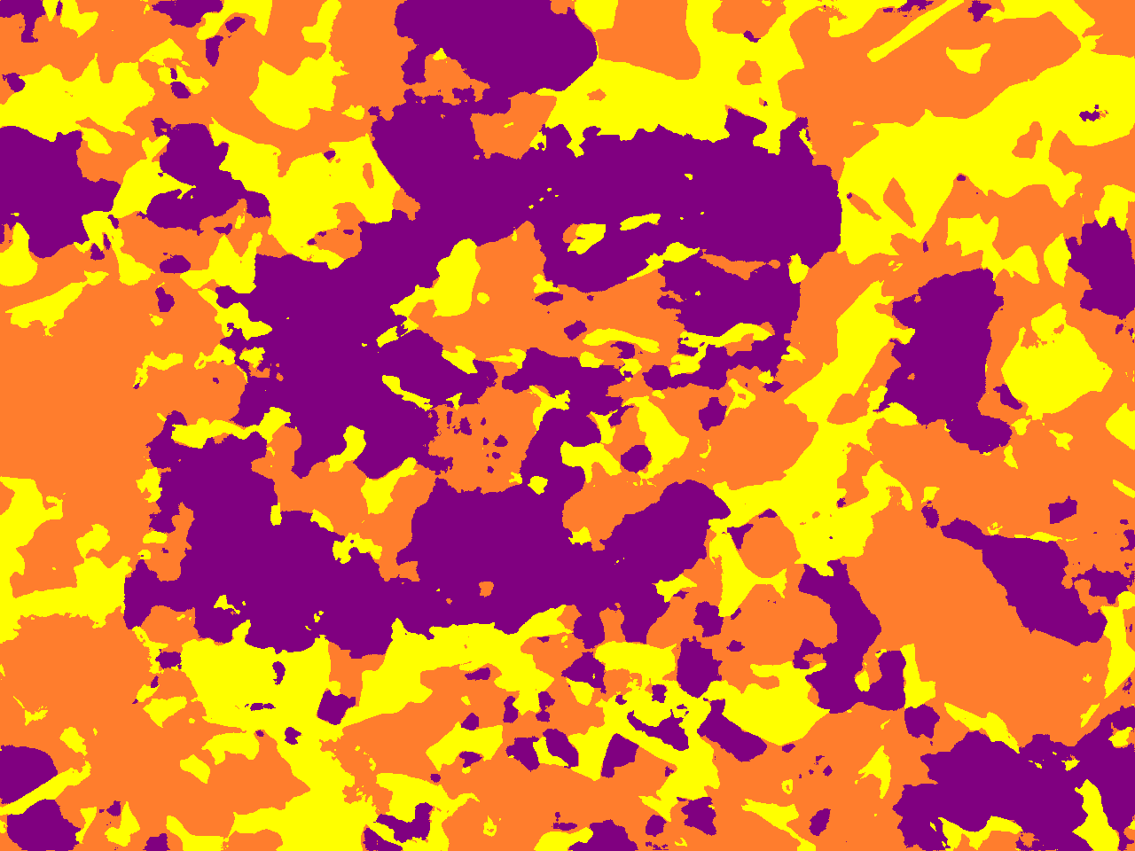
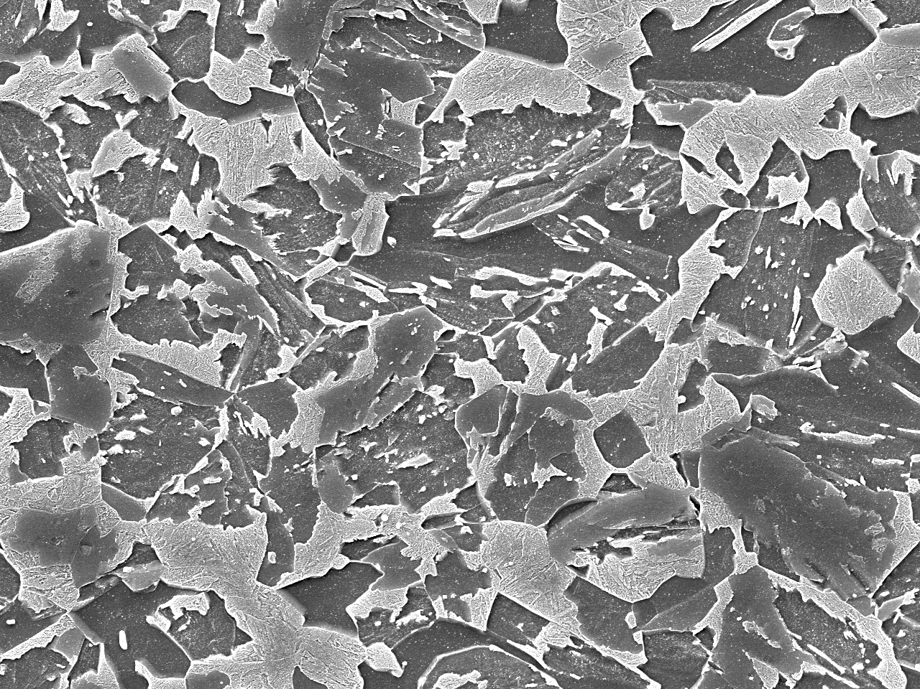
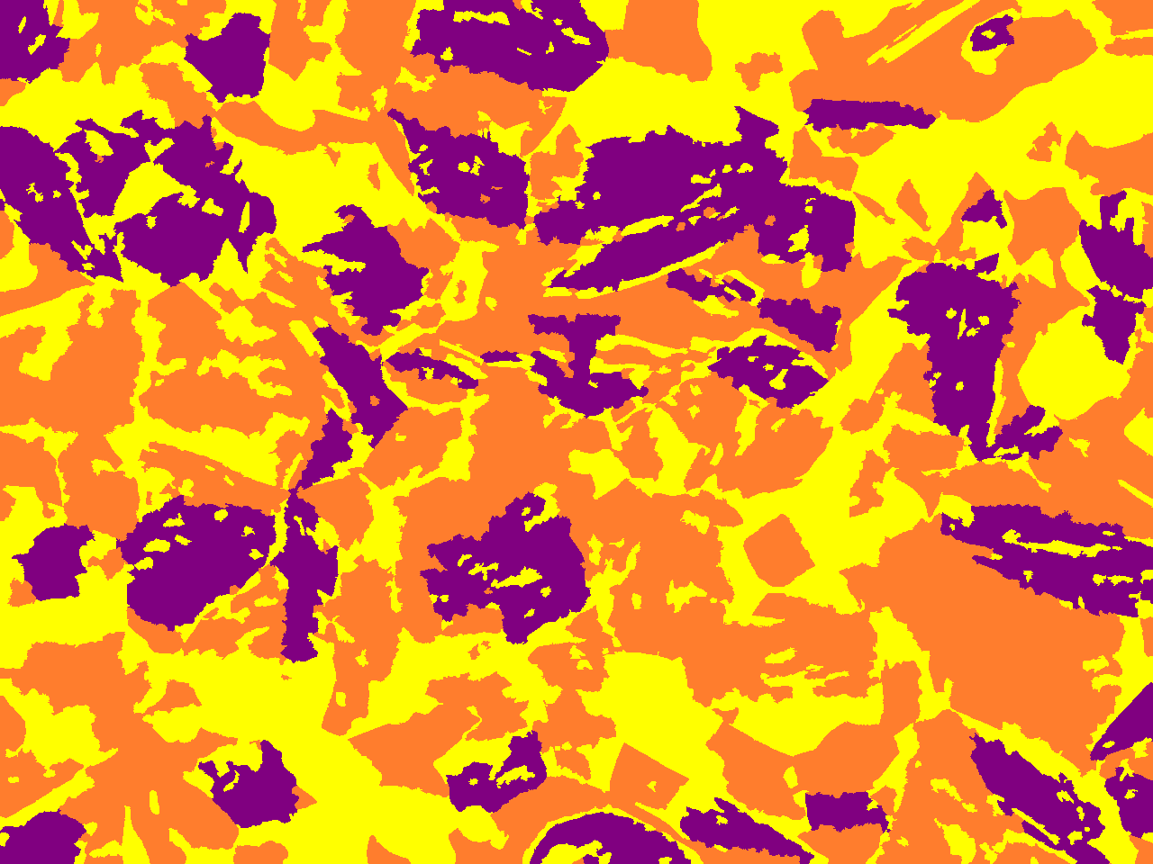
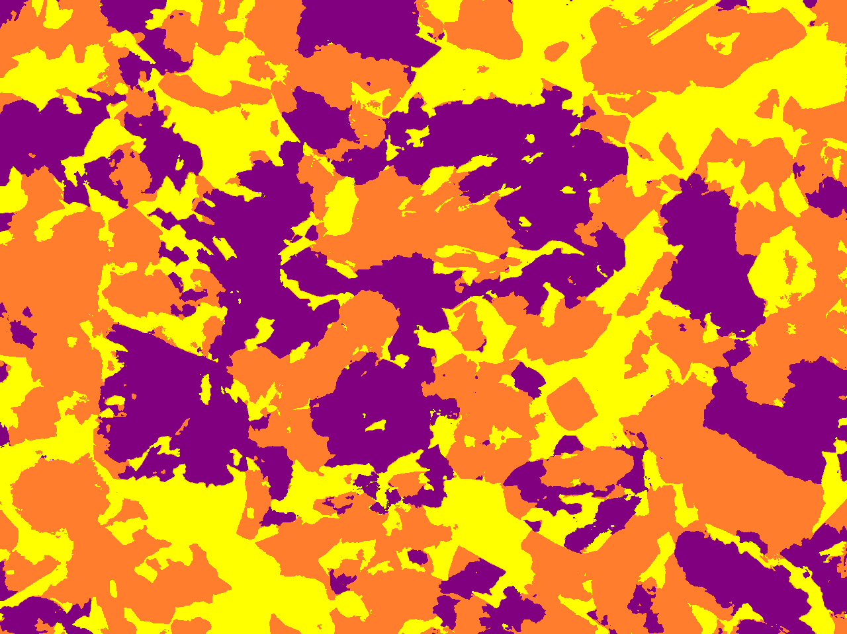
Comparative Images
H2 - Type
Our UNET Dice Score – 0.6902
UNET 3+ Dice Score – 0.7471
Dice

